Slide 1

Hospital Database Design
Interim Project for Module „Databases and SQL“
Notes:
Good Morning and welcome to my presentation. My presentation will cover our interim project for the Module „Databases and SQL.“ I chose to complete the guided Project A which deals with the creation of a database for a hospital.

Slide 2
Contents
Project Overview
My Approach: Initial Steps, Detailed Planning and Specific Tasks
Task Results: Summary of Relationships, ERD and Cardinalities
Questions?
Task Results: Normalization and SQL Script
Notes:
The contents of my presentation will include a broad Project Overview. My Approach to the project including my initial steps, the more detailed planning which followed and the Specific Tasks.. Next we will look at the results of the tasks – first a Summary of the Relationships and Cardinalities and the ERD. Following that we will review further task results including Normalization of the database and the created SQL Script. And finally, at the end there will be time for any questions you may have.

Slide 3
Project Overview Create a Database Schema for Hospital
Background Research
Determine what the key entities are through research
Interviews with staff and personnel as well as observing workflows
Specific Tasks
Entity Relationship Diagram
Write SQL code
Prepare PowerPoint Presentation
Notes:
Let‘s begin with our Project Overview by discussing our Background Research. Simply, the task was to design a database schema for a hospital. To begin we had to first determine what the key entities actually are and this required some research and investigative work: more on this point shortly. Then, once we had that information we could proceed to the practical tasks which included creating an Entity Relationship Diagram, writing the SQL code for the database and then preparing a this Powerpoint presentation to explain our process and results.

Slide 4

My Approach
First Step: Determine What Information is Required
Talk to all Relevant Staff Members
Observing the Workflows of the Hospital
Initial Consideration: Tables are needed for Patients and Staff
More Detailed Planning
Doctor’s Input:
Doctors primarily need patient diagnoses and information on prior treatment steps.
Important personal data include: First name, last name, age, gender (could affect treatment measures).
Emergency contact information.
Notes:
The first step in designing a database is to determine what information is required for that database. To do this effectively we have to do 2 things. First, we have to interview all relevant staff members, for example, the doctors of course. But not just the doctors we need to gather information from staff from all departments and groups including the nurses, maintenance staff, etc. However, many staff would not be familiar with database design so we also have to personally observe institutional workflows to gain additional critical information. This led us to determine that we would need at least 2 tables to start with – one for patients and one for staff. We then began our more detailed planning by talking in depth with one of our primary groups - the doctors. The doctor informed us that the patient‘s diagnosis is the most crucial piece of information as well as information concerning prior treatment. Of course, other relevant data needed here would include the patient‘s name, age. As well as other important factors like gender (which could affect treatment measures) and a way to contact patient‘s relatives if needed.

Slide 5
My Approach
Nurses Input:
Nurses need to know which medications are prescribed
Required care procedures
Patient appointments for tests like X-rays or ultrasounds
which should be recorded in the database
HR Department Input:
HR needs staff data
Name, address, gender, phone number, email, salary, and job role
Vacation schedules and work shifts
Notes:
Moving on to the input from the nurses who informed us of how important it is to know which medications are prescribed and which care proceedures are necessary. Also, certain patient appointments (like x-rays) are not usually conducted in patient‘s rooms so it is important to also have these in the database. In speaking with HR we learned that the department needs to have personal data of staff members and this could include; name, address, job role, etc. Also, it is vital for HR to track vacation schedules and work shifts.

Slide 6
My Approach
Administration Input:
Room capacity, ward type (regular or ICU).
Admission date, expected discharge date and actual discharge date.
Patient insurance details (private or public).
Conclusion: After collecting this information, we see we need to expand on our number of tables. We added tables for Doctors, Nurses, Appointments, Rooms, Medication and Medical Equipment.
Notes:
Finally, we met with representatives from the hospital administration. They informed us that they are responsible for room occupancy, therefore they need to note the capacity of the rooms . The capacity of the ward is also important as well as to distinguish between what type of ward, for example regular or ICU. It is also useful to record admission date, expected discharge date and actual discharge date. And last but not least for the administration, patient insurance details are also important. This led us to conclude that our initial 2 tables for patients and staff would certainly not be enough. In additon to Patients and Staff, we decided to create tables for Doctors, Nurses, Appointments, Rooms, Medication and Medical Equipment. Of course, there could be many more but „Rome wasn‘t built in a day“ and I believed this was enough to build a solid foundation for the database and satisfy the requirements of the project.

Slide 7
Task Results
Summary of Relationships/ERD
Creation and Normalization of Code
Implement Database in MySQL Workshop
Notes:
We can now look at the results of of our practical tasks – first, the summary of relationships which helped us create our ERD Diagram, the creation and normalization of the SQL code and its implementation in MySQL Workshop.

Slide 8
Summary of Relationships and Cardinalities
Entity 1 | Entity 2 | Relationship | Cardinality
Patients | Doctors | Attended by | Many-to-One
Patients | Nurses | Assisted by | Many-to-One
Patients | Rooms | Occupies | Many-to-One
Patients | Appointments | Has | One-to-Many
Patients | Medications | Prescribed | One-to-Many
Doctors | Appointments | Schedules | One-to-Many
Nurses | Appointments | Manages | One-to-Many
Staff | Rooms | Assigned to | Many-to-One
Staff | Medical Equipment | Uses | One-to-Many
Medical Equipment | Rooms | Located in | Many-to-One
Doctors | Rooms | Assigned to | Many-to-One
Notes:
Here we can see a detailed Explanation of Relationships: As you can see….
Patients – Doctors Many-to-One: A patient is assigned to one doctor, but a doctor can attend to many patients.
Patients – Nurses Many-to-One: A patient is assisted by one nurse per appointment, but a nurse can assist multiple patients.
Patients – Rooms Many-to-One: A patient occupies one room at a time, but a room can accommodate multiple patients depending on capacity.
Patients – Appointments One-to-Many: A patient can have multiple appointments with different doctors or nurses.
Patients – Medications One-to-Many: A patient can be prescribed multiple medications.
Doctors – Appointments One-to-Many: A doctor can have multiple appointments with different patients.
Nurses – Appointments One-to-Many: A nurse can manage multiple appointments.
Staff – Rooms Many-to-One: A staff member is assigned to one room, but a room can have multiple staff members working in it.
Staff – Medical Equipment One-to-Many: A staff member can use multiple pieces of medical equipment.
Medical Equipment – Rooms Many-to-One: Each piece of medical equipment is located in one room, but a room can have multiple pieces of equipment.
Doctors – Rooms Many-to-One: A doctor can be assigned to one room (e.g., an office), but a room can host multiple doctors.

Slide 9
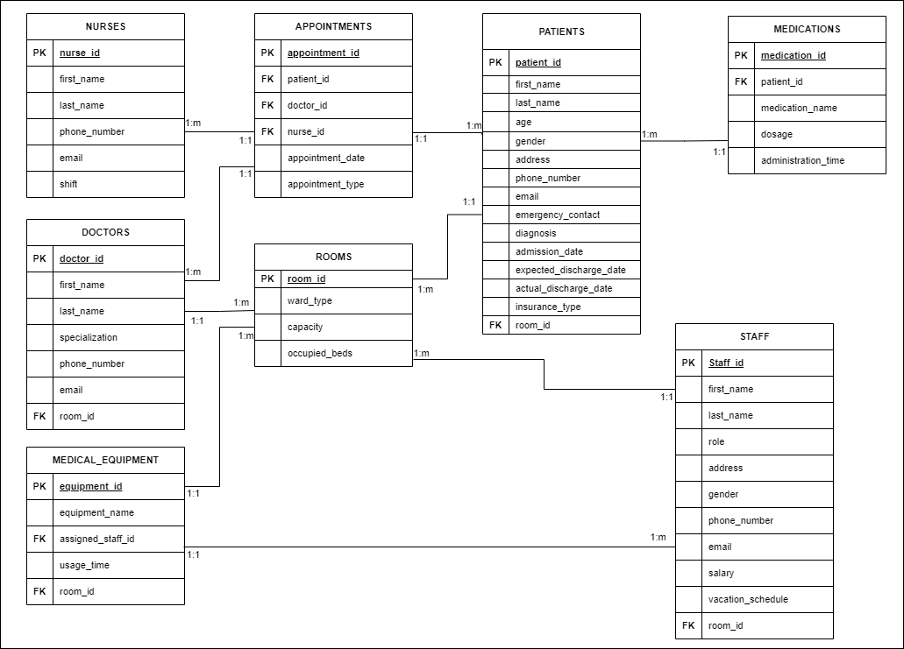
ERD
Notes:
This summary helped me to create my ERD. Though I didn‘t follw the summary perfectly which I will explain shortly. I created 2 versions of the ERD. The first in draw.io. In this version It is a bit easier to find the primary keys and foreign keys related to the various tables. For example, in the appointments table you can see that there is a primary key assigned as well as 3 foreign keys.
One of my biggest questions here was whether or not to include direct relationships between patients and doctors or patients and nurses, for example. Current Design: Indirect Relationships Through Appointments
In the current schema, relationships between Patients, Doctors, and Nurses are established via the Appointments table:
The Appointments table contains:
patient_id (FK) → Links to the Patients table.
doctor_id (FK) → Links to the Doctors table.
nurse_id (FK) → Links to the Nurses table.
Advantages of Indirect Relationships
Simplicity and Flexibility:
Reduces redundancy by avoiding direct links between tables that can already be joined through the Appointments table.
Keeps the design clean and easy to maintain.
Scalability:
Allows for tracking multiple appointments for each patient, doctor, and nurse.
Supports cases where a patient may see different doctors or nurses over time.
Normalization:
Avoids data redundancy and maintains a normalized design (3NF).
Prevents duplication of data that could lead to inconsistency.
Query Flexibility:
You can still generate reports showing which doctors and nurses are associated with which patients by joining the tables through Appointments.
So I researched the question when would these direct relationships be needed?
Direct relationships between Patients and Doctors or Patients and Nurses might be necessary in the following scenarios:
Persistent Assignment - If each patient is permanently assigned to a primary doctor or nurse, independent of specific appointments.
Frequent Access: If queries frequently need to access a patient’s primary doctor or nurse without needing appointment details.
Additional Business Logic: If you need to enforce rules like “Each patient must have one primary doctor assigned” at the database level.
Knowing these relationships can always be added later I chose not to add them here. My decision was to stick with the current design (indirect relationships through Appointments) to maintain flexibility, simplicity, and normalization.

Slide 10
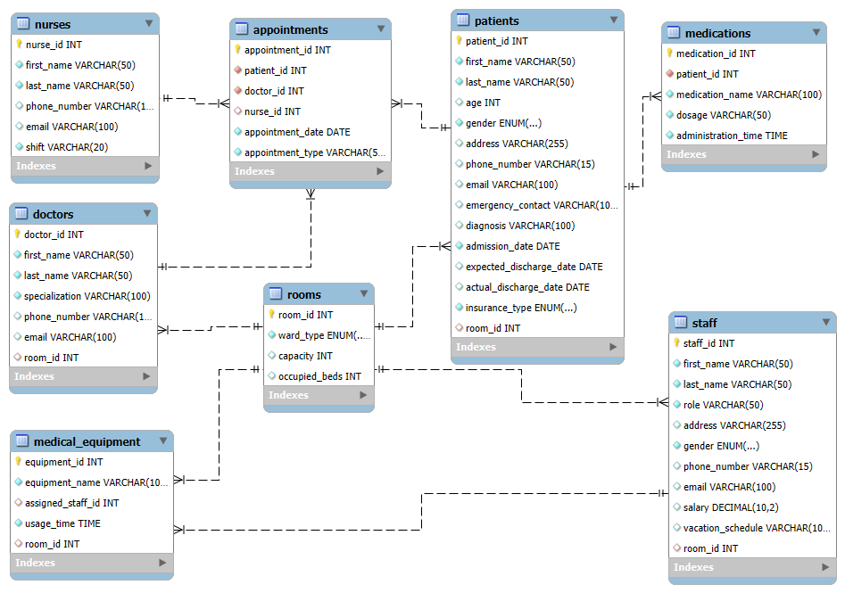
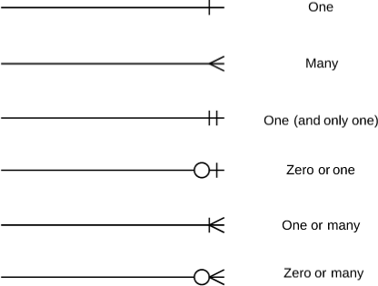
EER
Diagram Notation
Notes:
The second ERD or the EER (enhanced entity relationship) diagram was generated after preparing the SQL code. I wanted to import this as an interactive chart but ran out of time (and know-how). I found having both versions quite helpful and a good way to check and double-check my initial diagram.

Slide 11
Normalization
CREATE TABLE Staff (
staff_id INT PRIMARY KEY AUTO_INCREMENT,
first_name VARCHAR(50),
last_name VARCHAR(50),
role VARCHAR(50),
address VARCHAR(255),
gender ENUM('Male', 'Female', 'Other'),
phone_number VARCHAR(15) UNIQUE,
email VARCHAR(100) UNIQUE,
salary DECIMAL(10, 2),
vacation_schedule VARCHAR(100)
);
1NF: All values are atomic (smallest possible units)
2NF: The table has a single-column primary key (staff_id),
and all attributes depend on staff_id.
3NF: No transitive (indirect) dependencies.
Conclusion:
The database schema is normalized up to 3NF. All tables meet the criteria for 1NF, 2NF, and 3NF. There are no partial dependencies or transitive dependencies, ensuring data integrity and minimal redundancy.
Notes:
Before implementing the database in mySQL the data needed to be normalized. Simply put, data normalization improves data integrity and reduces redundancy, which, together, ensure that you can maintain accurate and consistent records. I have one table shown here as an example… I did this for all table sand came to the conclusion that indeed the schema was normalized up to….

Slide 12
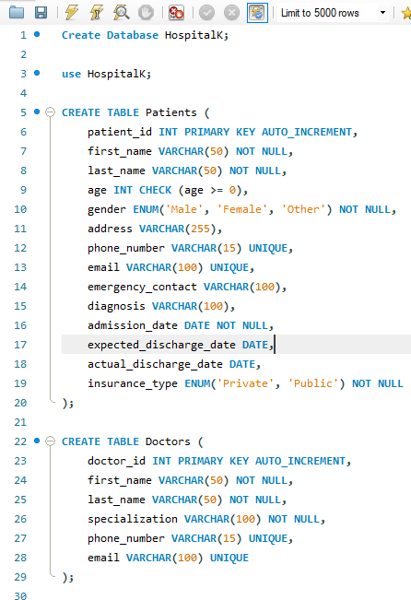
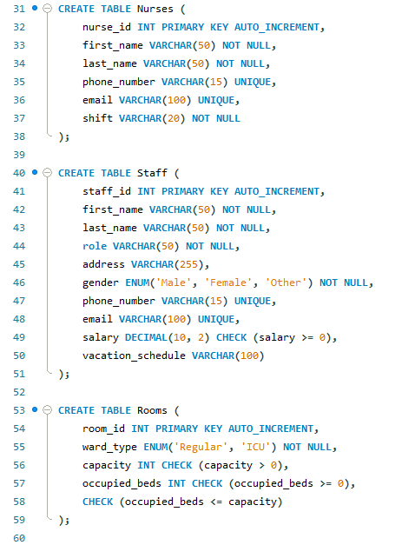
SQL Script
Notes:
Finally we were ready with our script. This was definitely a work in progress over time. My original script looked nothing like this and obviously got modified and added to as I worked on the normalization.

Slide 13
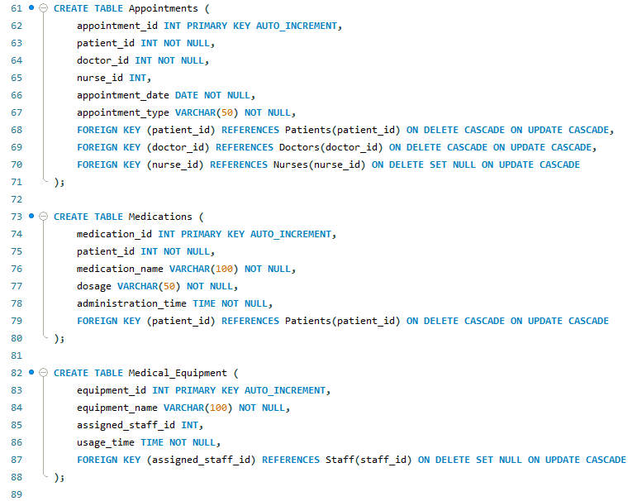
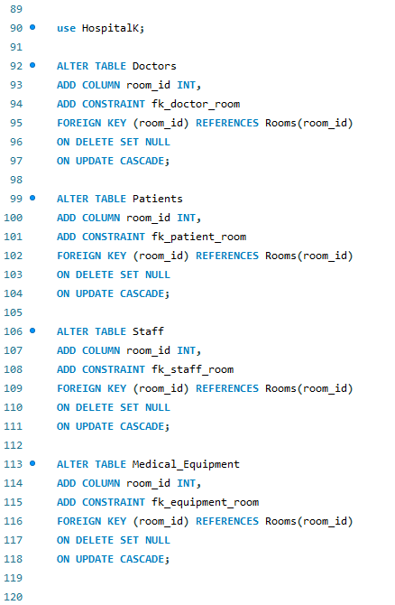
SQL Script
Notes:
You can see here that I also didn‘t have everything necessary from the first try and had to alter a number of tables (mostly by adding foreign keys…) However, in the end the script was successfully implemented and the database was created!

Slide 14
Conclusions
Challenges
Similar to Excel project, making the right decisions
Defending those decisions
Future Improvements
Increase technical skills (wanted an interactive EER diagram)
Conclusions
Project successfully implemented
Hard work but definitely helped me learn a lot
Helped me to see the „big picture“
Notes:
Of course, there were challenges along the way - similar to our Excel project, one of my peronal challenges is with decision making…what do I need, what is nice to have, a couple of examples; how many tables are really needed, the question of indirect vs. direct relationships …..the script was successfully implemented and the database was created! The project was Hard work but helped me earn a lot (Not only database creation and SQL, but working with the other tools and programs for example Powerpoint, Draw.io. We are learning this step by step and this helped me to see a bigger picture and how all the steps, pieces fit together.

Slide 15
Questions?
Thank you for your time and attention!
Notes:
Before we finish there is now time to answer any questions you may have. If not, thank you for your time and attention!

